Slide 2
England, Wales, and Scotland make up Great Britain (often called simply Britain), and these countries plus Northern Ireland form the United Kingdom.

Slide 3
For years English cuisine was regarded as bland and unexciting. This reputation has changed as English chefs have become more adventurous, earning praise for their innovative and flavorful dishes. Although most English food is not spicy or unusual, it is hearty and delicious. It relies on fresh, simple ingredients prepared to highlight the natural flavors of foods. English cooking also incorporates influences from the many cultures that make up the English population, such as East Asian, West Indian, and Chinese communities.

Slide 4
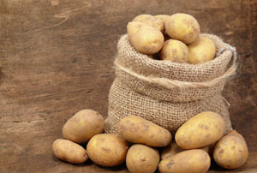
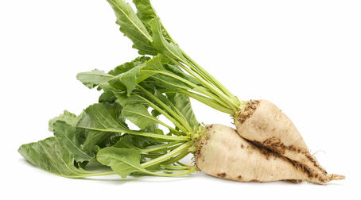
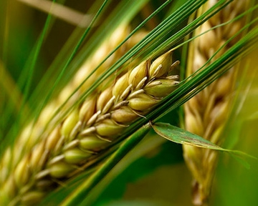
English farmers grow barley, potatoes, wheat, sugar beets, and other crops. Oats are grown in the high, rugged hills and wild moors of northern England. The county of Kent, in the southeast, is called the Garden of England and is famous for its apple and cherry orchards.

Slide 5
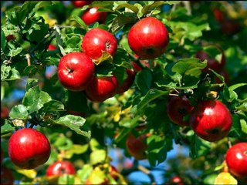
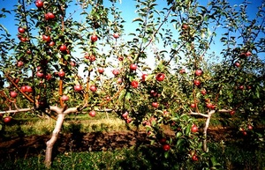
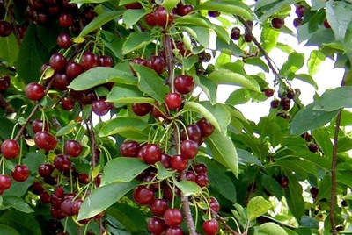

Slide 7
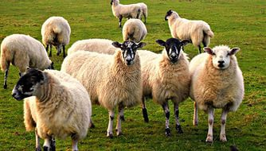
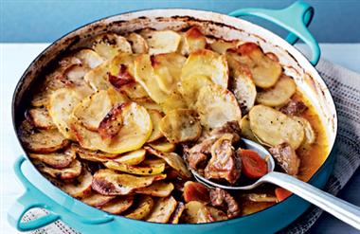
Sheep have always been important both for their wool and their meat. Lamb is the main ingredient in the Lancashire hot pot
In many English homes, the traditional Sunday meal is a joint, or roast, of beef.

Slide 8
People in England eat fish as much as meat. Since no point in the British Isles is more than seventy miles from the sea, fresh fish is available everywhere, all year long. Common types include mackerel, cod, haddock, salmon, and Dover sole. Shellfish, such as crabs, mussels, and oysters, is available in many coastal towns. In the East End of London, street vendors sell dishes of prawns, whelks, and cockles, all sprinkled with malt vinegar.

Slide 9
Mackerel

Slide 10
cod

Slide 11
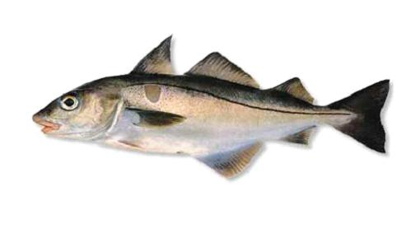
Haddock

Slide 12
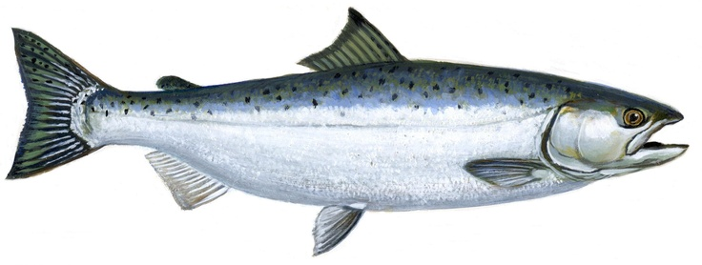
Salmon

Slide 13
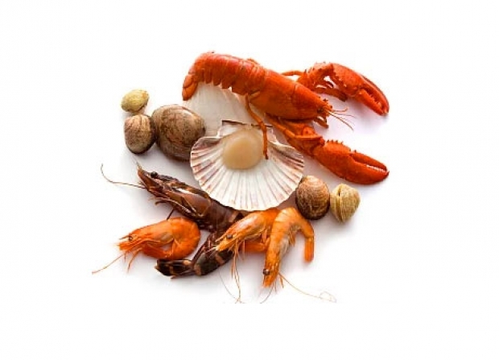
Shellfish

Slide 14
crabs

Slide 15
mussels

Slide 16
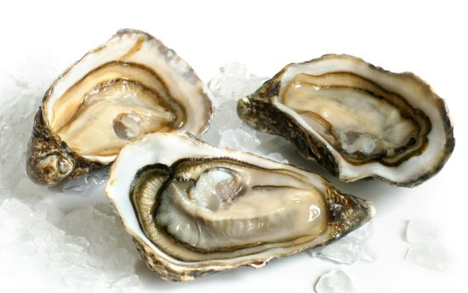
oysters

Slide 17
prawns

Slide 18
England also produces outstanding dairy products, including a wealth of local cheeses. The most famous are Cheddar, from the village of Cheddar in the west of England, and Stilton, from a district of the same name in central England

Slide 19
Cheddar

Slide 20
Stilton

Slide 21
The largest Cheddar cheese ever made weighed 1,100 pounds and was given to Queen Victoria as a wedding present in 1840.

Slide 22
Spices are mostly used:
Bay leaves, Coriander Seed, Cinnamon, Horseradish Powder, Yellow Mustard, Nutmeg, Poppy Seed, Allspice, Anise Seed, Basil, Caraway, Cayenne, Chives, Clove, Fennel, Garlic, Ginger, Lemon Zest, Mace, Marjoram, Mint, Parsley, Pepper (Black and White), Rosemary, Sage

Slide 23
Bay leaves

Slide 24
Coriander Seed

Slide 25
Cinnamon

Slide 26
Horseradish Powder

Slide 27
Yellow Mustard

Slide 28
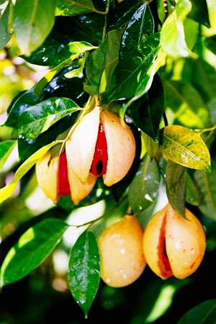
Nutmeg

Slide 29
Poppy Seed

Slide 30
Allspice

Slide 31
Anise Seed

Slide 32
Basil

Slide 33
Mint

Slide 34
Lemon Zest

Slide 35
Rosemary

Slide 36
sage

Slide 37
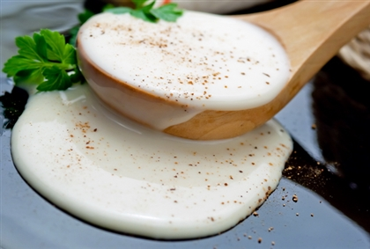
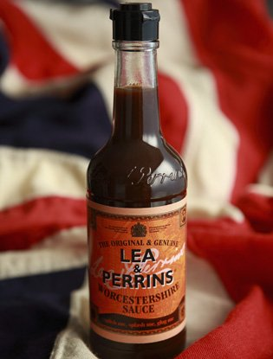
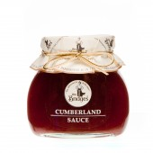
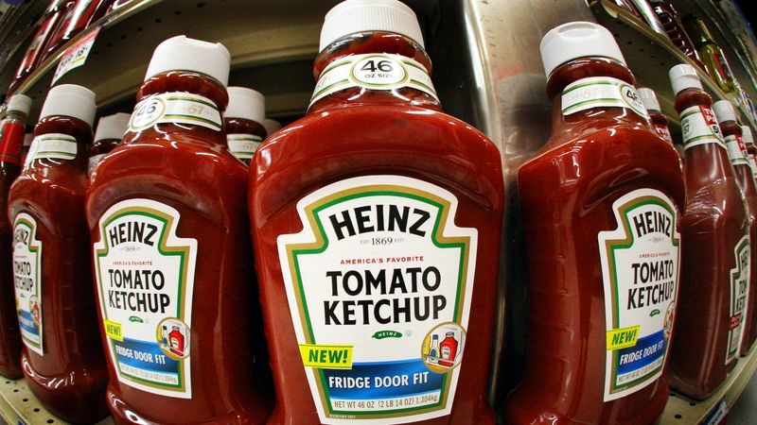
Gravy is the most common sauce made at home, with variants such as onion gravy being popular.
Other than gravy, perhaps the most common sauce made at home is a white sauce (which the French call "béchamel".)
Mint sauce is still sometimes made at home, as it is easily made with vinegar, sugar and fresh chopped mint from the back garden. Other sauces still made at home include Bread Sauce and Cumberland Sauce.
Sweet sauces such as a custard sauce, cranberry sauce, apple sauce.
Popular commercial sauces include Ketchup (the most popular brand is Heinz), brown sauce (the most popular brand is HP), Worcestershire Sauce (the most popular brand is Lea & Perrins), creamed horseradish (aka horseradish sauce, as opposed to the grated), and mayonnaises (purchased), both regular and flavoured varieties.

Slide 39
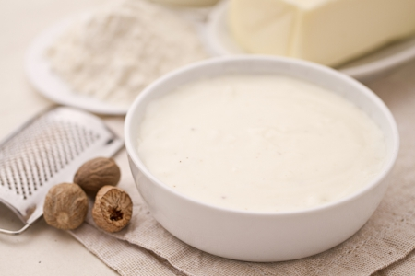
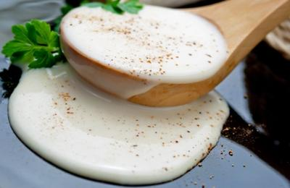
béchamel

Slide 41
Mint sauce

Slide 42
apple sauce

Slide 43
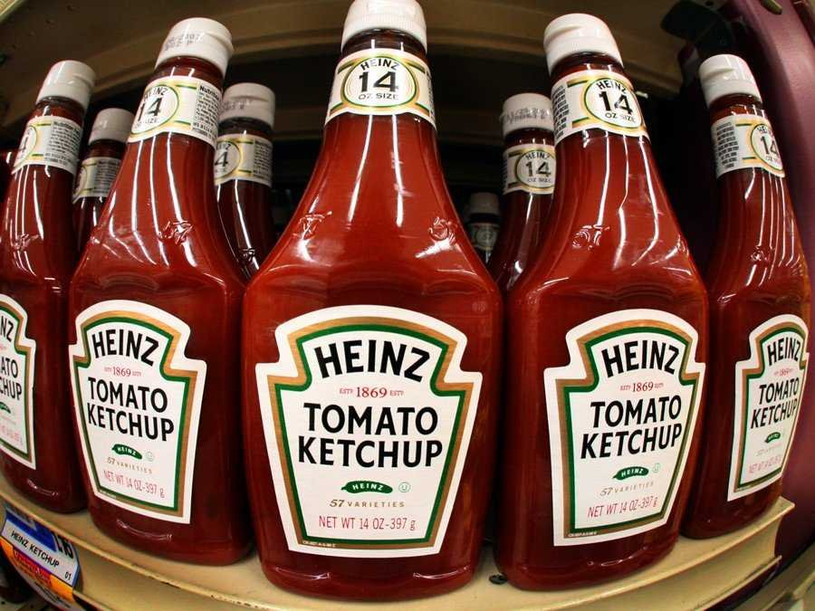
Ketchup Heinz

Slide 44
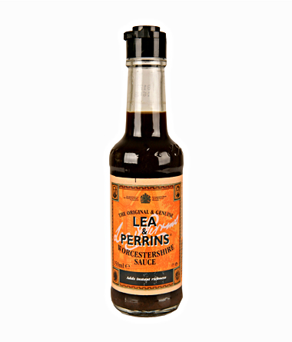
Worcestershire Sauce

Slide 45
English wine, Welsh wine, Irish whiskey, Plymouth gin, Scotch whisky, Ale, Tea

Slide 46
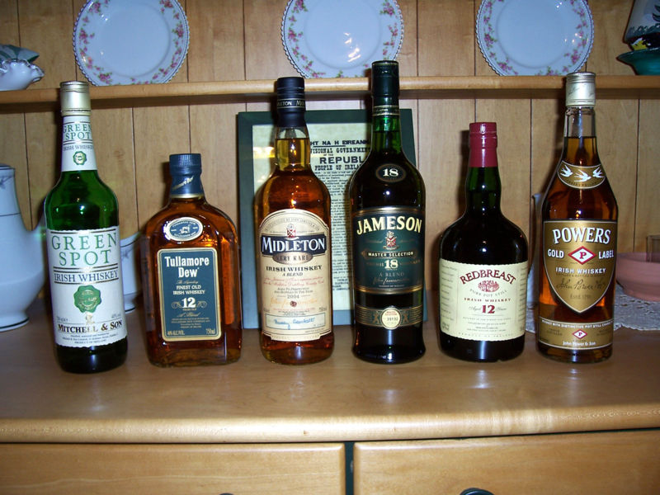
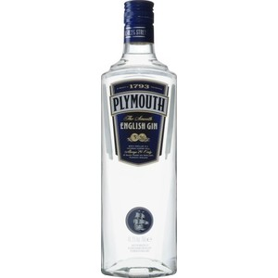
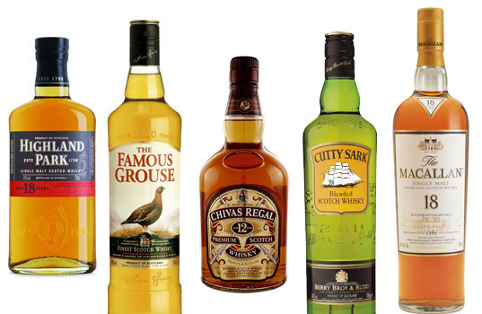
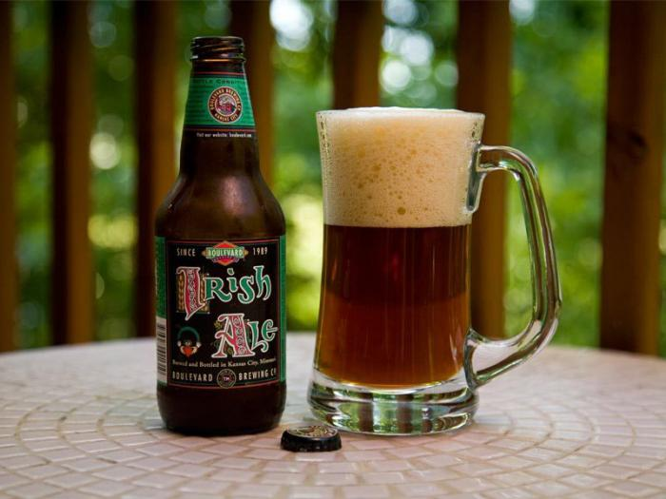

Slide 47
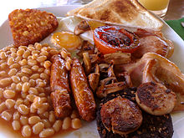
A traditional British breakfast
It is known for its amazing size and variety. It can include hot or cold cereal, fruit, juice, a “fry-up” of bacon, sausage, mushrooms, tomatoes, and bread—and, of course, eggs. To complete the meal, add a pot of steaming tea or coffee and hot buttered toast with marmalade. In the past, this filling meal gave laborers and farmers fuel for a long day of hard work. These days, most families eat a smaller breakfast, such as cereal and toast, pancakes or oatcakes (a pancake that looks like a scone or biscuit), or yogurt and fruit. But every once in a while, it’s a treat to have a big breakfast.

Slide 50
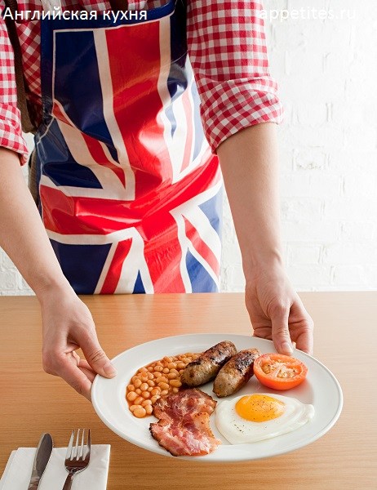
The traditional English breakfast consists of eggs, bacon, sausages, fried bread, baked beans and mushrooms.

Slide 51
Teatime is an important English custom. At about 4:00 each afternoon, many people pause for a soothing cup of hot tea and a bite to eat. Afternoon tea can range from a simple cup of tea to a formal meal that includes sandwiches, scones, and a variety of cakes and tarts. At a formal tea, the cakes and sandwiches are served on fine china, and the table may be decorated with a pretty tablecloth, silver utensils, and fresh flowers. At some fancy hotels, the serving of the tea is even accompanied by an orchestra.

Slide 55
Lunch
Lunch in England is served between 12:00 and 2:00 P .M. A hearty lunch may consist of “meat and two veg” and pudding. The meat is often a stew, and the vegetables usually include a starchy one, such as potatoes, and a green one, such as cabbage. On most days, people prefer to eat a lighter lunch, such as fish, a salad, a baked potato (called a jacket potato), or a sandwich.

Slide 58
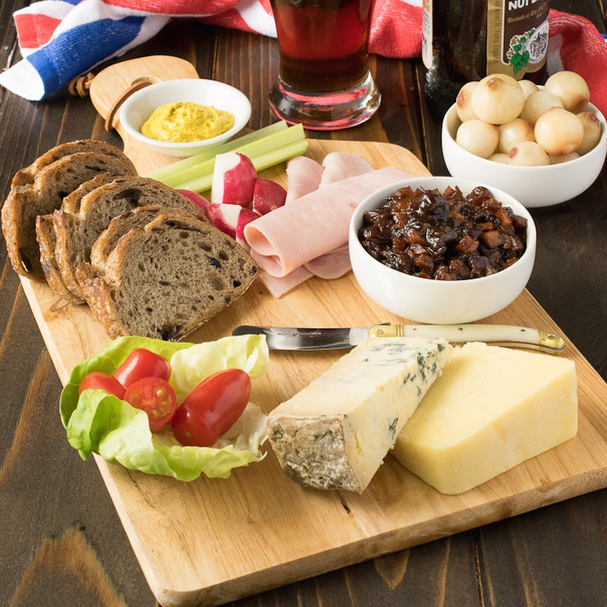
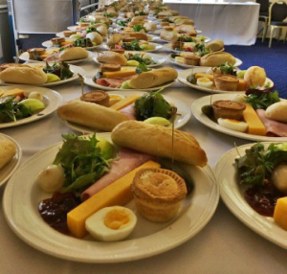
The most common lunch served at pubs is the “ploughman’s lunch,” which started as a meal for farmworkers. This is a platter containing cheese (often Cheddar), crusty white or brown bread, butter, and a pickled onion or two.

Slide 60
What is a typical English lunch?
Many children at school and adults at work will have a 'packed lunch'. This typically consists of a sandwich, a packet of crisps, a piece of fruit and a drink. The 'packed lunch' is kept in a plastic container.

Slide 61
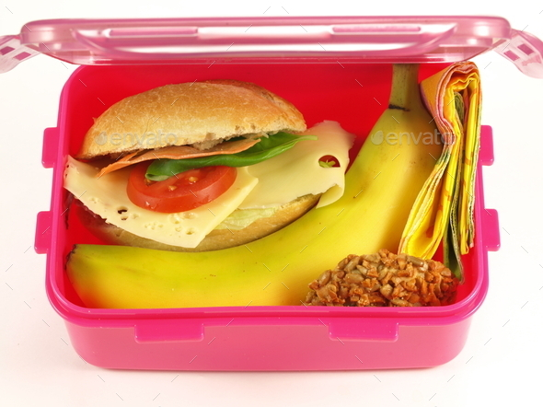
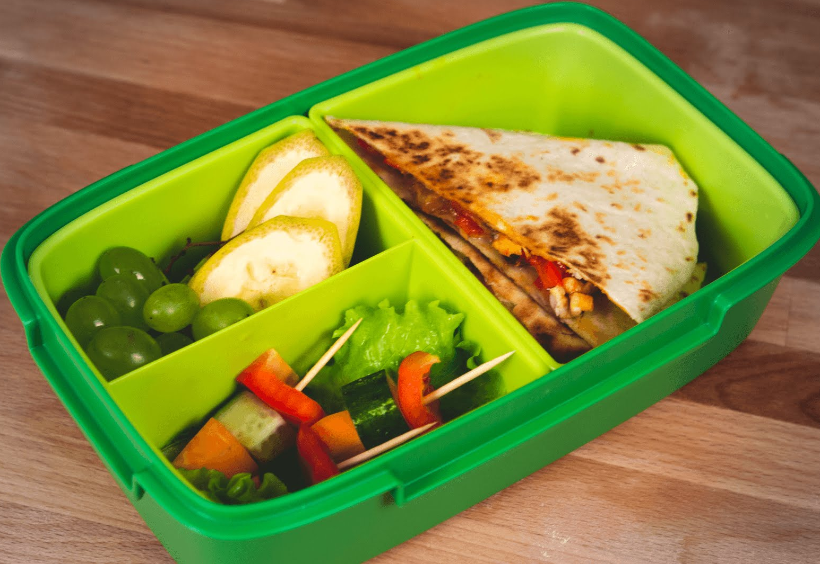

Slide 62
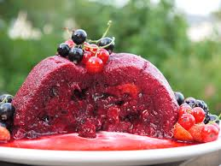
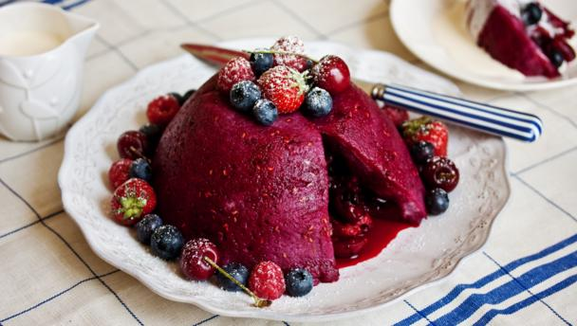
Sunday lunch is usually a larger and more formal meal. A popular Sunday lunch is a large joint of beef, mutton, or lamb roasted in the oven, accompanied by roast potatoes and other vegetables, with a pudding for dessert.
Summer pudding

Slide 63
Sunday lunch time is a typical time to eat the traditional Sunday Roast. Traditionally it consists of roast meat, (cooked in the oven for about two hours), two different kinds of vegetables and potatoes with a Yorkshire pudding. The most common joints are beef, lamb or pork; chicken is also popular.
Beef is eaten with hot white horseradish sauce, pork with sweet apple sauce and lamb with green mint sauce. Gravy is poured over the meat.

Slide 66
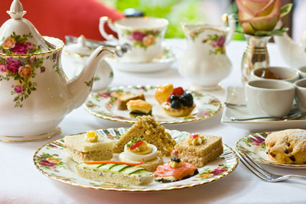
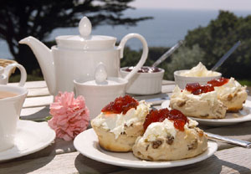
Supper
In England, supper can be any meal eaten from 6:00 P .M. to late at night. Only a very formal meal eaten rather late would be called dinner. If supper is eaten before 6:00 P .M., it might be called high tea. This would include a combination of tea and supper dishes. But most people eat supper between 6:00 and 7:00 P .M. Supper usually consists of a main dish and a dessert. After dessert, people sometimes have cheese and crackers. Coffee is served after dessert, either at the table with the cheese and crackers or by itself

Slide 68
What is a traditional English Dinner?
A typical British meal for dinner is meat and "two veg". We put hot brown gravy, traditionally made from the juices of the roast meat on the meat and usally the vegetables. One of the vegetables is almost always potatoes.
This traditional meal is rarely eaten nowadays, a recent survey found that most people in Britain eat curry! Rice or pasta are now favoured as the 'British Dinner'.
Vegetables grown in England, like potatoes, carrots, peas, cabbages and onions, are still very popular.

Slide 71
Every part of England has its own specialties, from the Cornish pasties of Cornwall to the Lancashire hot pot to Yorkshire pudding. Among the hundreds of regional specialties are gingerbread from the Lake District in northern England; Staffordshire oatcakes, a type of pancake; Cumberland sausage; and apple cider from the West Country (the counties of Somerset, Dorset, Devon, and Cornwall).
In addition, spicy dishes from India and the Caribbean, referred to simply as curries, are popular throughout England.

Slide 72
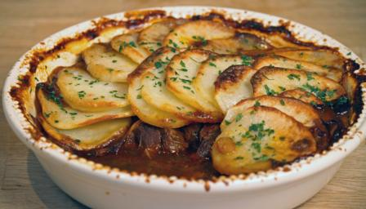
hot pot

Slide 73
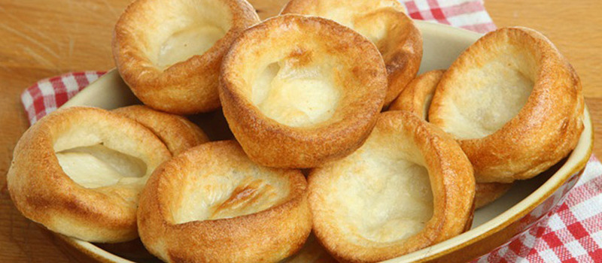
Yorkshire pudding

Slide 74
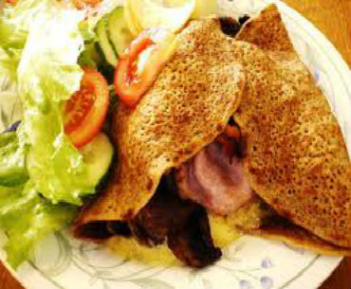
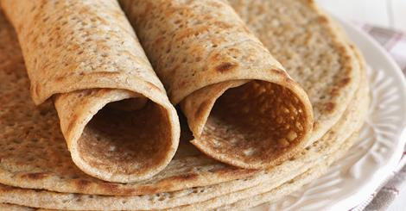
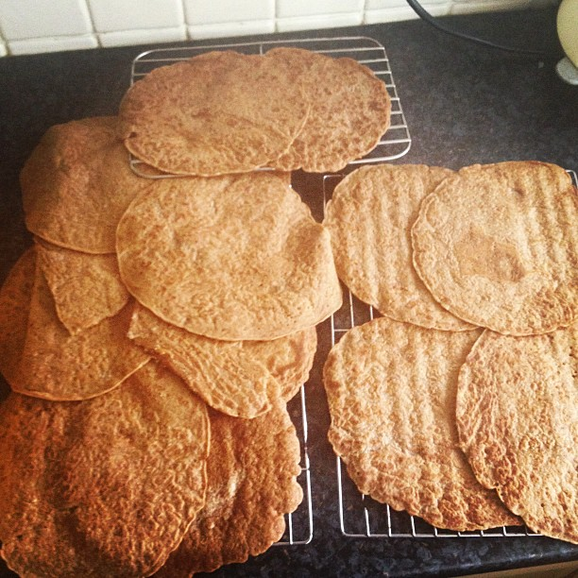
Staffordshire oatcakes

Slide 75
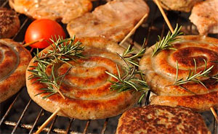
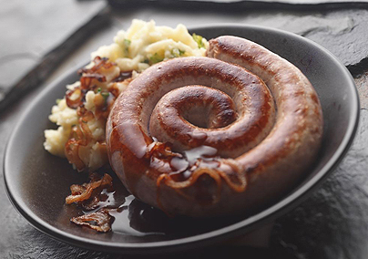
Cumberland sausage

Slide 76
apple cider

Slide 77
Many English people refer to all desserts as “puddings.” In England, a pudding may be many things besides a creamy milkbased dessert. It might be a pie or a sponge cake. It can be hot or cold, but most often it will be hot, to help keep warm in the cold, damp English weather.

Slide 78
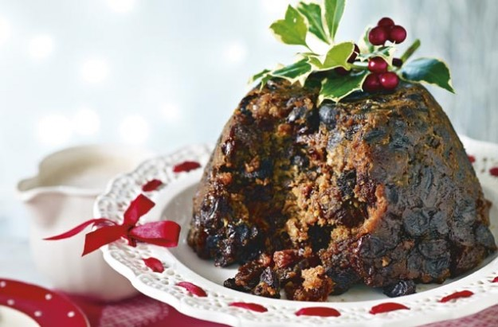
Holiday and Festival Food
Food often takes center stage during holiday celebrations. Perhaps the most famous holiday fare is Christmas pudding, a steamed dessert filled with dried fruits, such as plums and currants, and topped with a sweet sauce. At Easter, English cooks bake many types of sweets, such as hot cross buns or Easter biscuits. In Cornwall, an Easter specialty is bright yellow saffron buns, made with a spice that comes from the crocus flower.

Slide 79
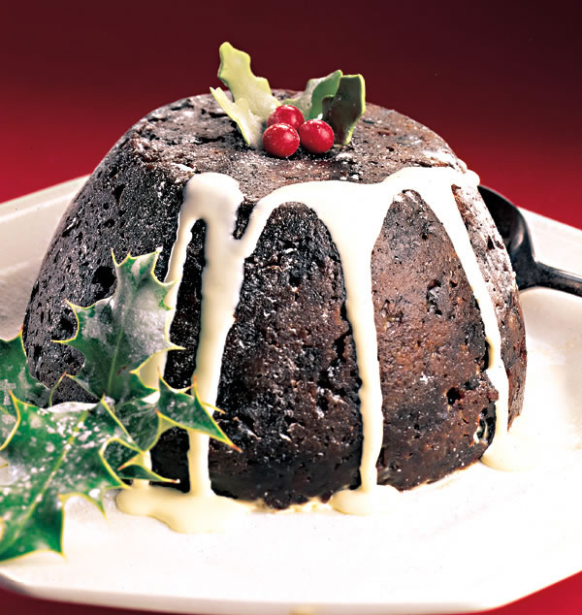
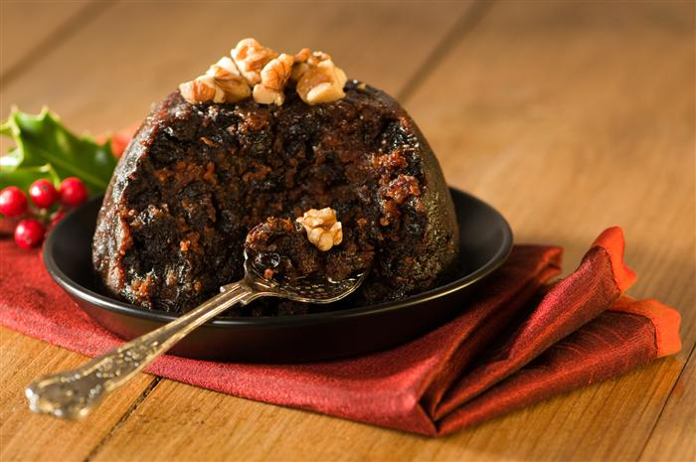
Christmas pudding

Slide 80
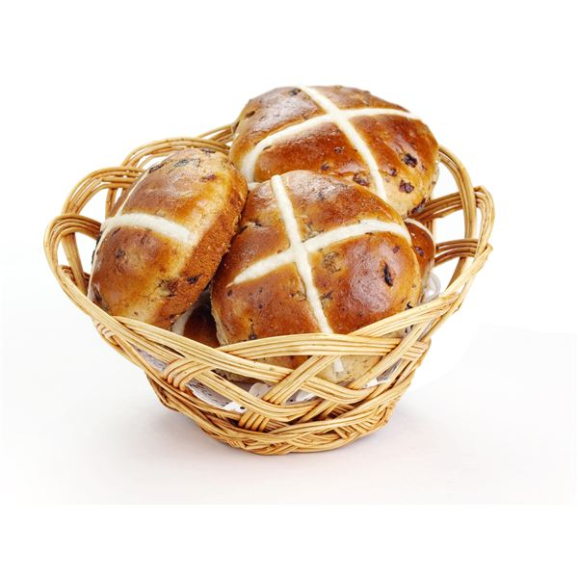
cross buns

Slide 81
saffron buns

Slide 82
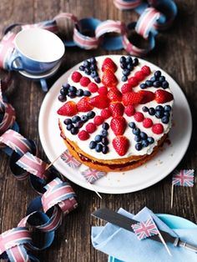
The End
Thanks for attention

