Slide 1
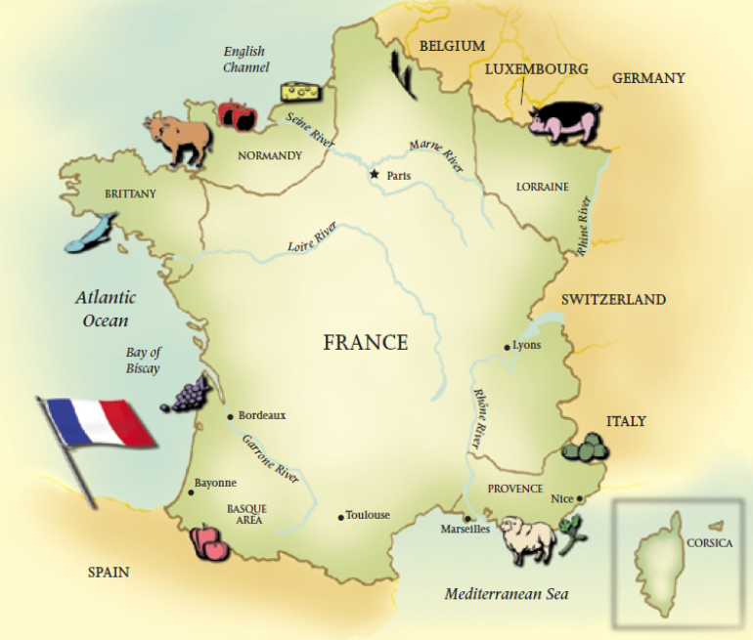
France

Slide 2
Geography has an important effect on the cooking of each region of France.

Slide 3
Normandy

Slide 4
cattle

Slide 7
orchards grow

Slide 8
apples

Slide 9
Cream and cheeses

Slide 10
Brittany

Slide 12
lobsters

Slide 13
shrimp

Slide 14
mussels

Slide 15
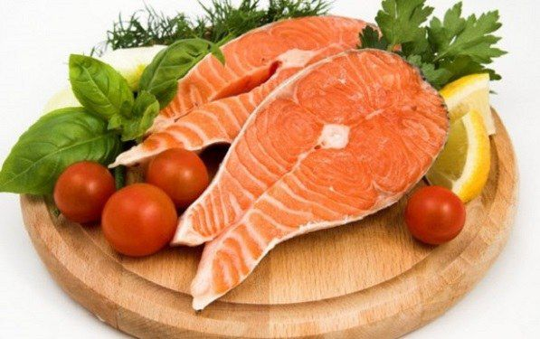
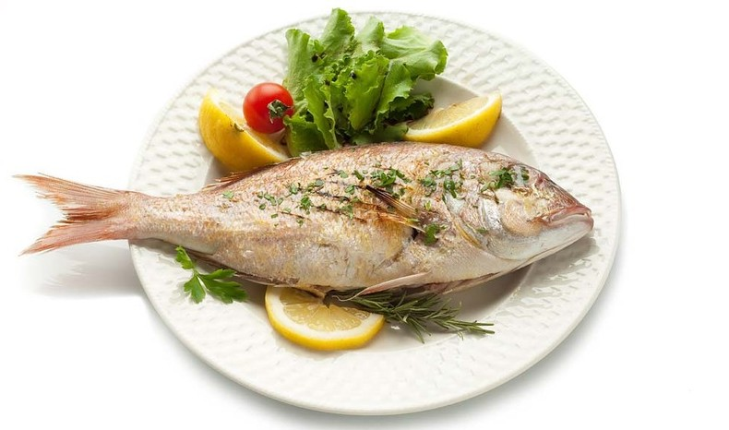
saltwater fish

Slide 16
southern France

Slide 17
tomatoes

Slide 18
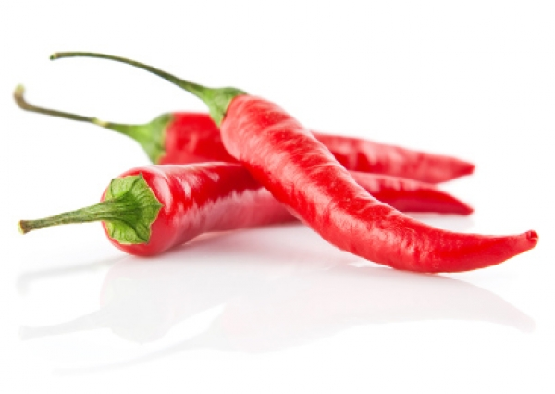
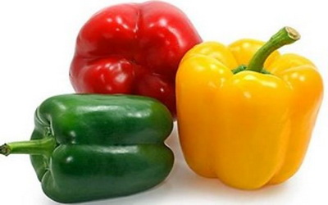
peppers

Slide 19
sausages

Slide 20
Provence

Slide 22
Olives

Slide 23
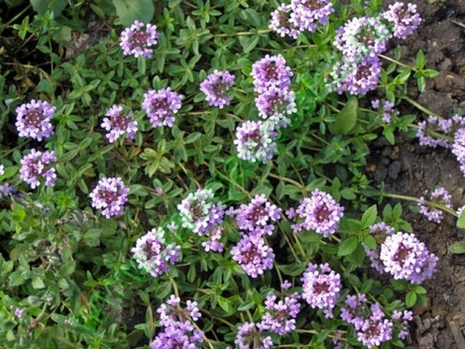
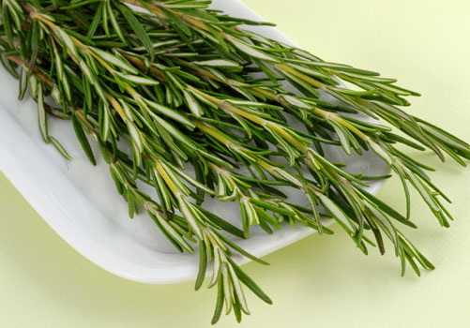
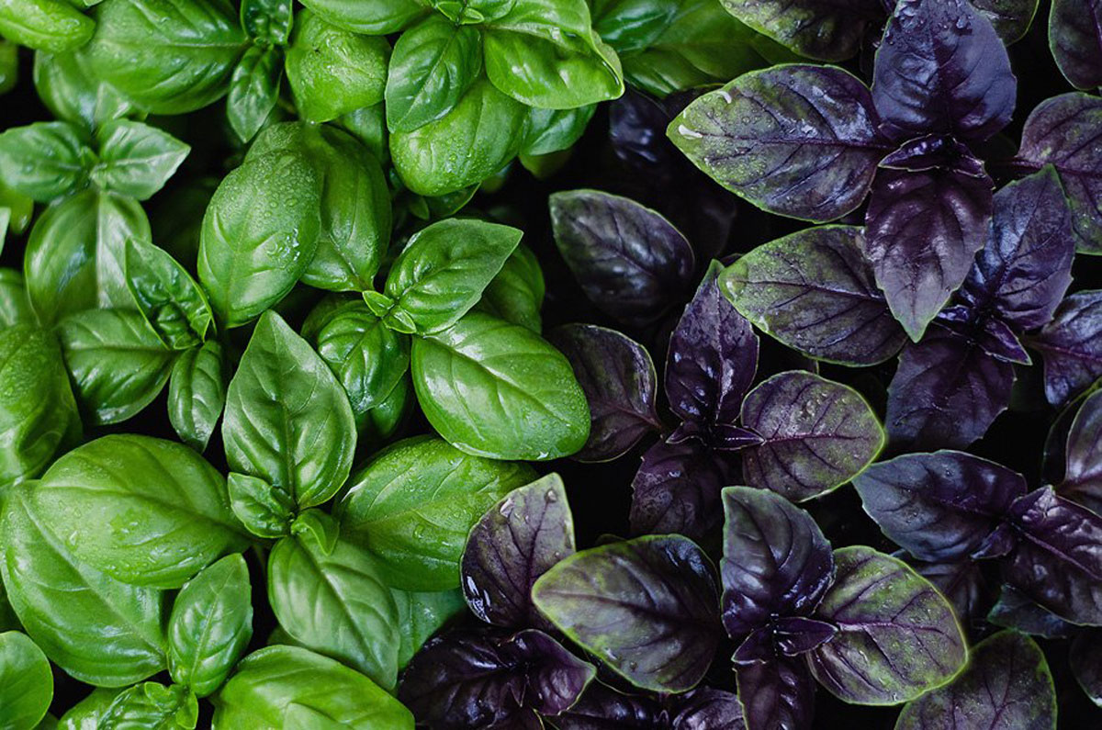
herbs

Slide 24
Holidays and Festivals

Slide 25
Easter, or les Pаques

Slide 27
foiegras—a goose-liver

Slide 28
pâté—lamb

Slide 29
salmon

Slide 30
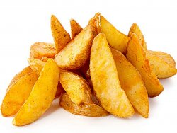
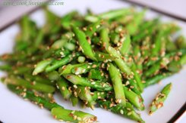
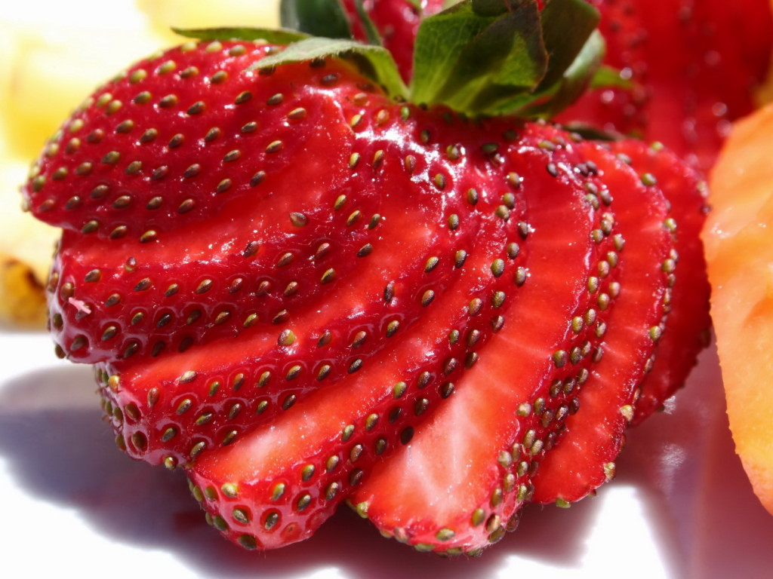
new potatoes
asparagus
strawberries

Slide 31
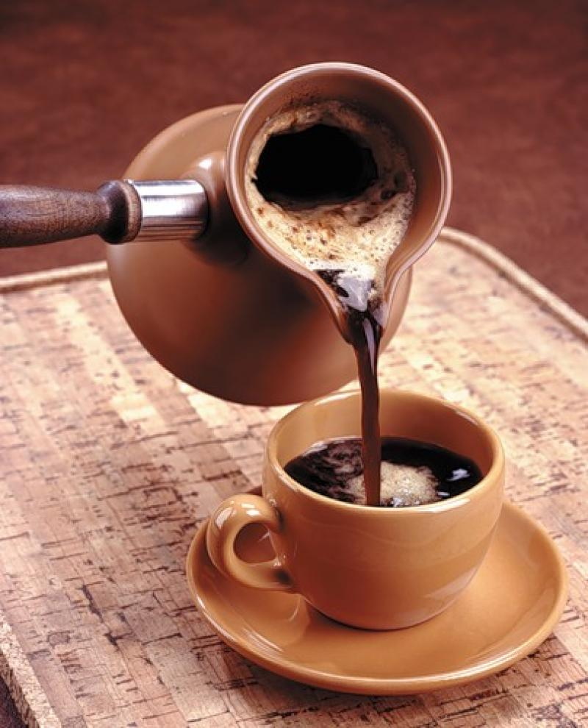
Coffee
liqueur
chocolates round

Slide 32
bakeries churn

Slide 33
Мain course.
Alsace region

Slide 34
roasted goose

Slide 35
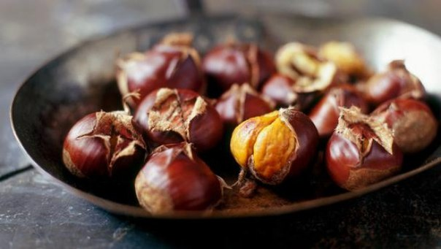
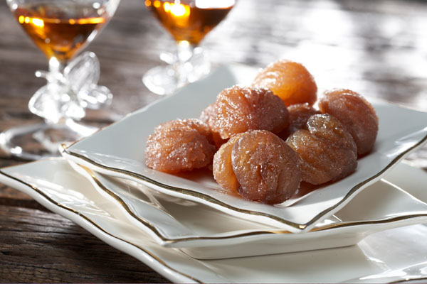
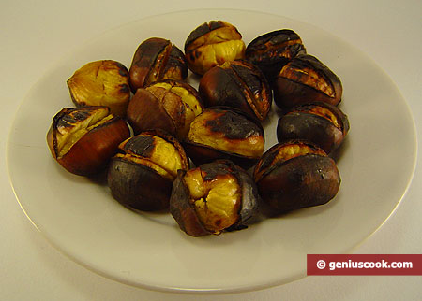
chestnuts

Slide 36
Turkey

Slide 37
Desserts

Slide 38
dried fruit

Slide 39
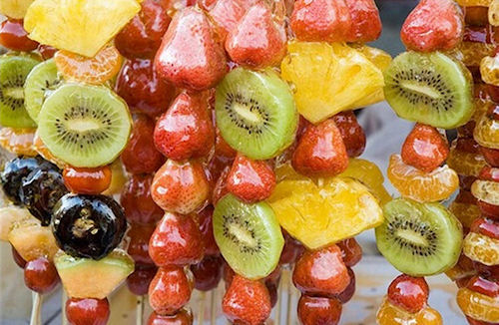
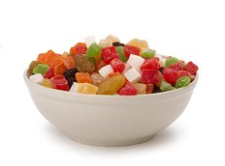
candied fruit

Slide 40
marzipan

Slide 41
cookies

Slide 42
French Breakfast

Slide 43
Croissants

Slide 44
coffee

Slide 45
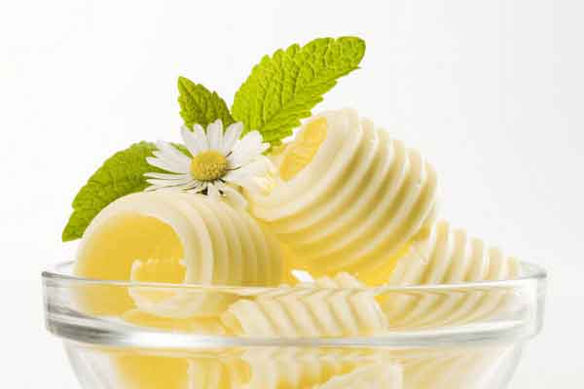
baguette with butter

Slide 46
Lunch/Le Dеjeuner

Slide 47
Hearty soups

Slide 48
French bread

Slide 49
omelets

Slide 50
quiches

Slide 52
dessert of cheese and fruit

Slide 53
tart apples

Slide 54
Traditional French Soups

Slide 55
Bouillabaisse

Slide 56
Pumpkin Soup

Slide 57
Chestnut Soup

Slide 58
Snack/Le Casse-Croute

Slide 59
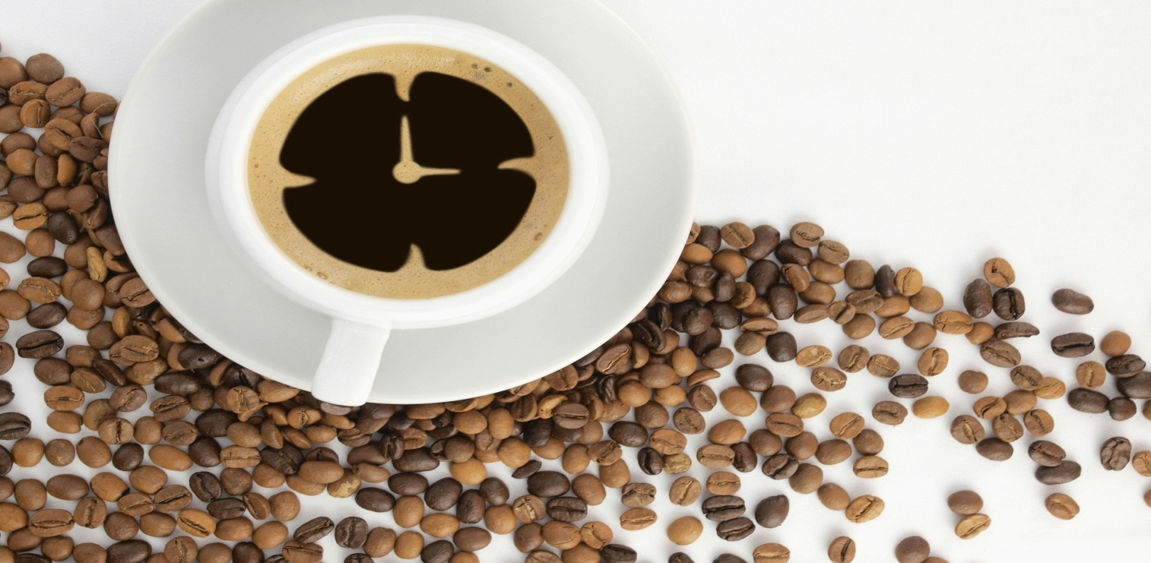
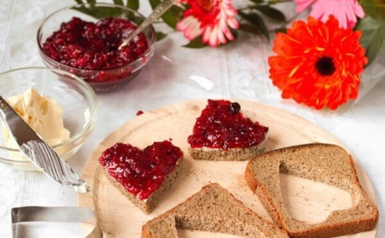
strong coffee
Bread with butter and jam
pastry

Slide 60
Dinner and Dessert

Slide 62
Foods for Which the French are Famous

Slide 63
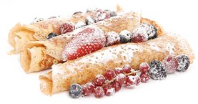
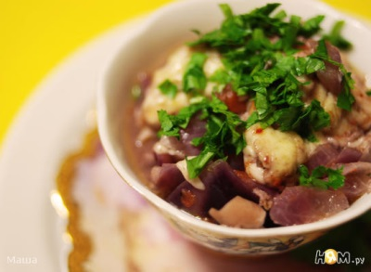
Crêpes
Coq Au Vin (chicken frickasee)

Slide 64
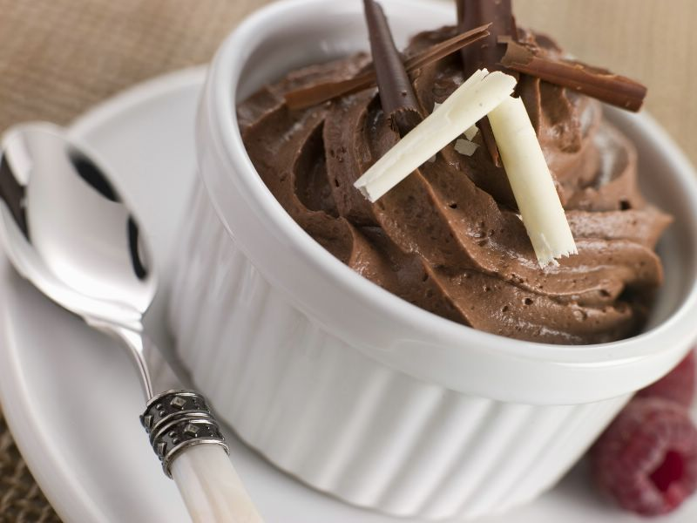
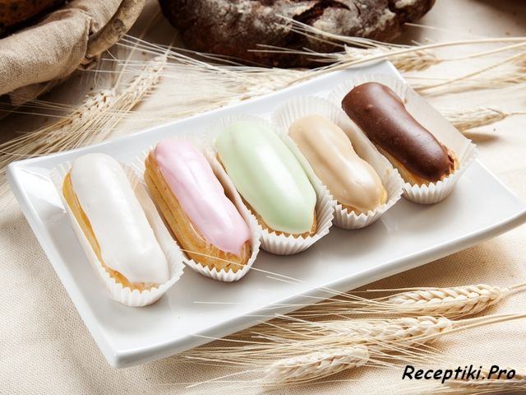
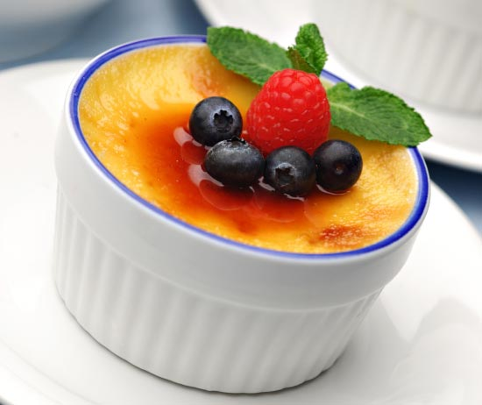
Chocolate mousse
Éclair
Crème Brûlée

Slide 65
Wine

Slide 66
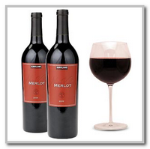
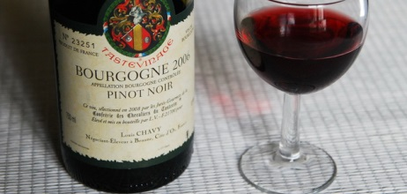
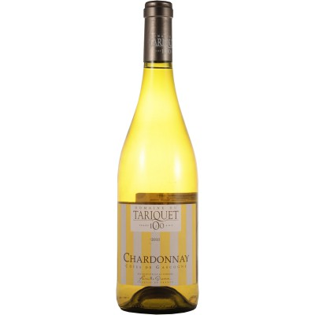
Merlot
Burgundy
Chardonnay

Slide 67
Fruits

Slide 68
